Slide 1

AI-Based Network Intrusion Detection System
DIPANSHU DHAGE
dipanshu9131@gmail.com

Slide 2
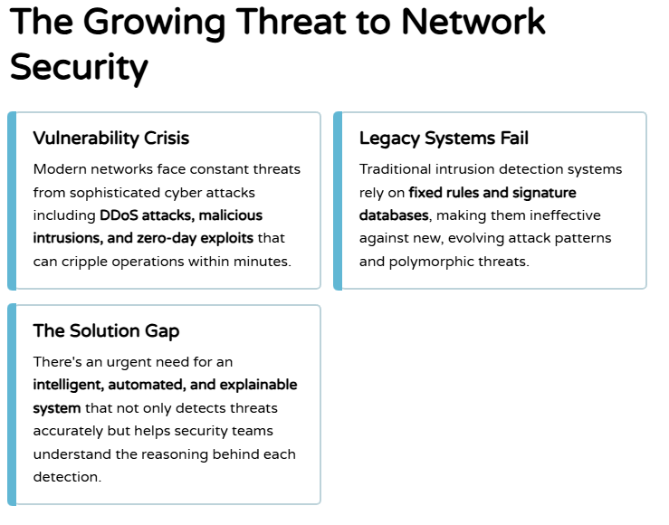

PROBLEM STATEMENT

Slide 3
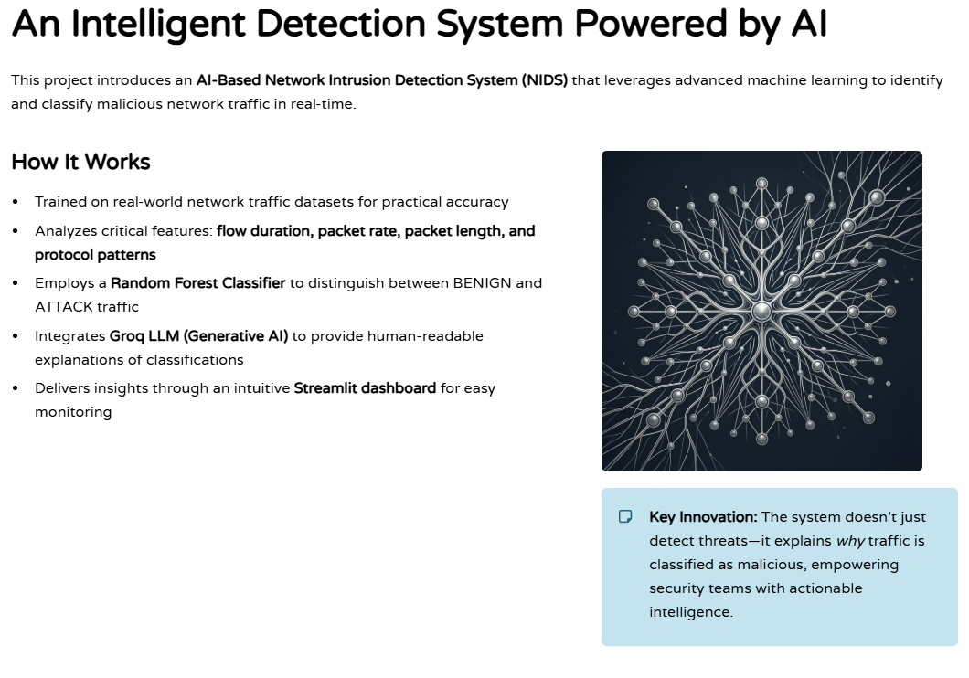
Project Description

Slide 4
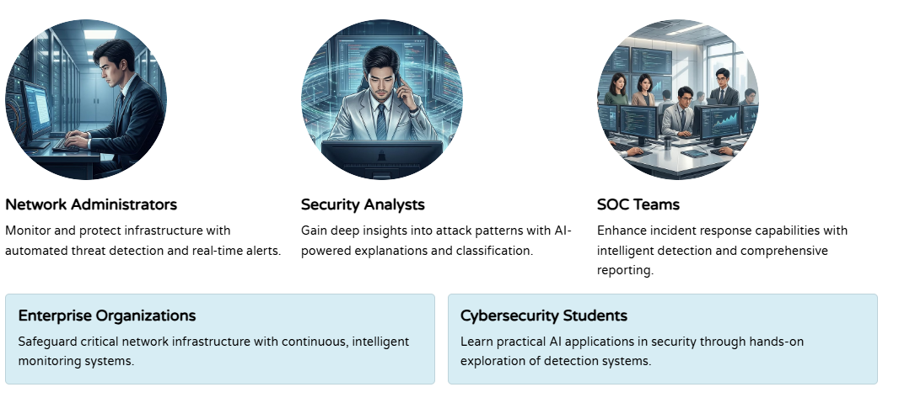

WHO ARE THE END USERS?

Slide 5
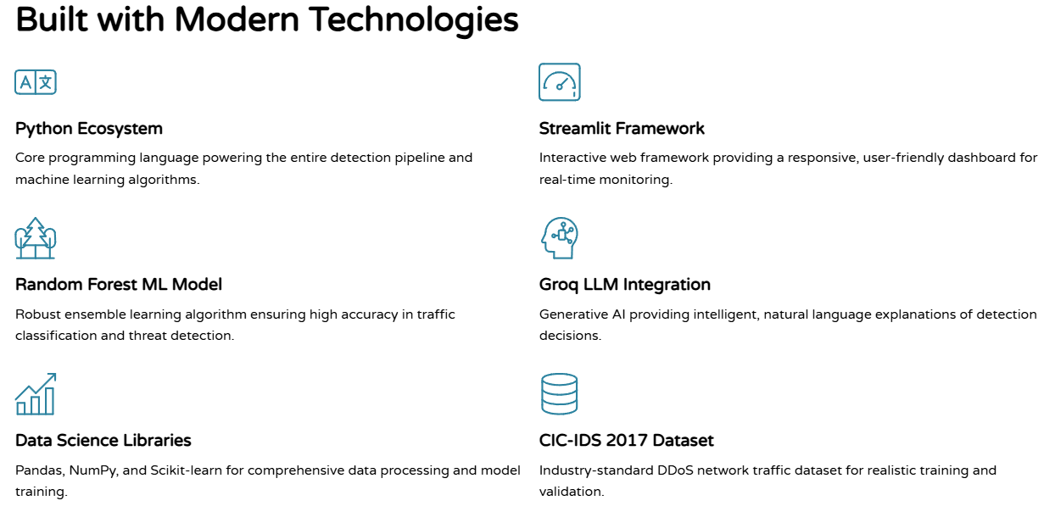
Technology Used

Slide 6
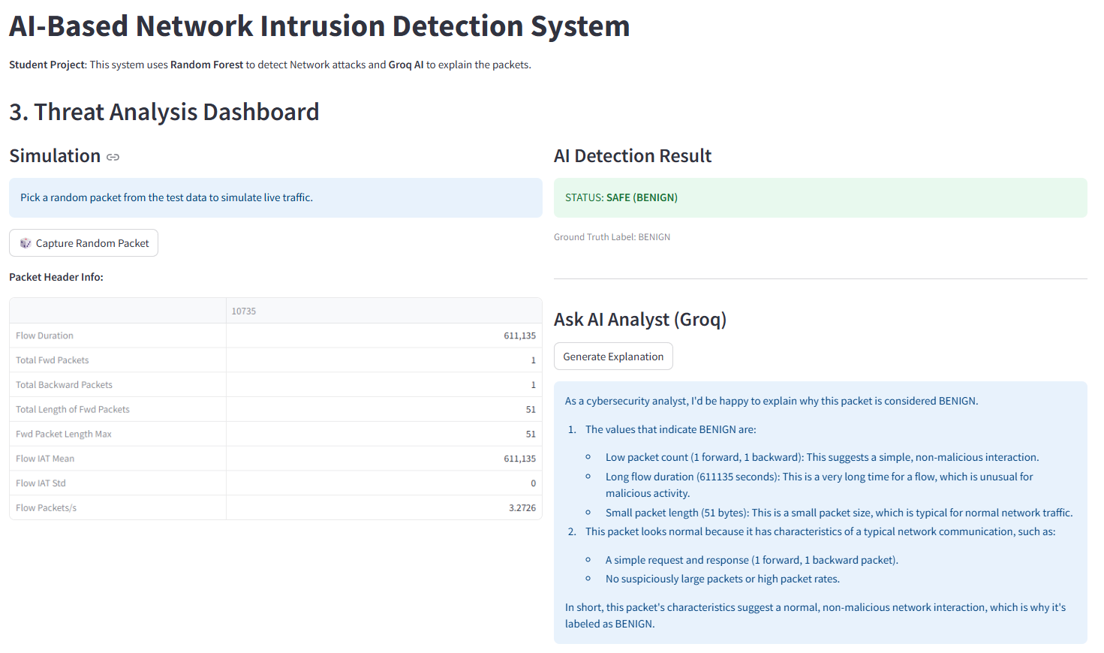
RESULTS
Experience It Live
Explore the working demo:
https://huggingface.co/spaces/anshu91/AI-Based-Network-Intrusion-Detection-System

Slide 7

.
.
View Live Demo

